Slide 1


Feasibility Study of Generative AI in Automotive Cybersecurity Threat Modelling
14 May 2024

Slide 2








Company - Secure Elements Ltd
An Automotive Cybersecurity Engineering Software Company
Founded – Jan 2022
Mission – Help In Shaping Safe and Secure Future Mobility
We Build Engineering Tooling Products
CRISKLE – Integrated Product Security Lifecycle Application
CRISKLE VSoC – Vehicle Security Operations Centre
Mr. Saket Mohan
Founder & CEO
Sampath
Lead Embedded AI Engineer
Proud Members Of
Auto Isac
2

Slide 3




Feasibility Study
GenAI in Automotive Cybersecurity Threat Modelling
Project Name | GenAI in Automotive Cybersecurity Threat Modelling
Project Number | 10080056
Start Date | 1st Oct 2023
End Date | 30th March 2024
Project Funding | GBP 50,000 (Grant) Sector - Transport
Funding Agency | Innovate UK
Project Partners | Secure Elements Ltd (Lead) Swansea University Techworks (AESIN)
3

Slide 4
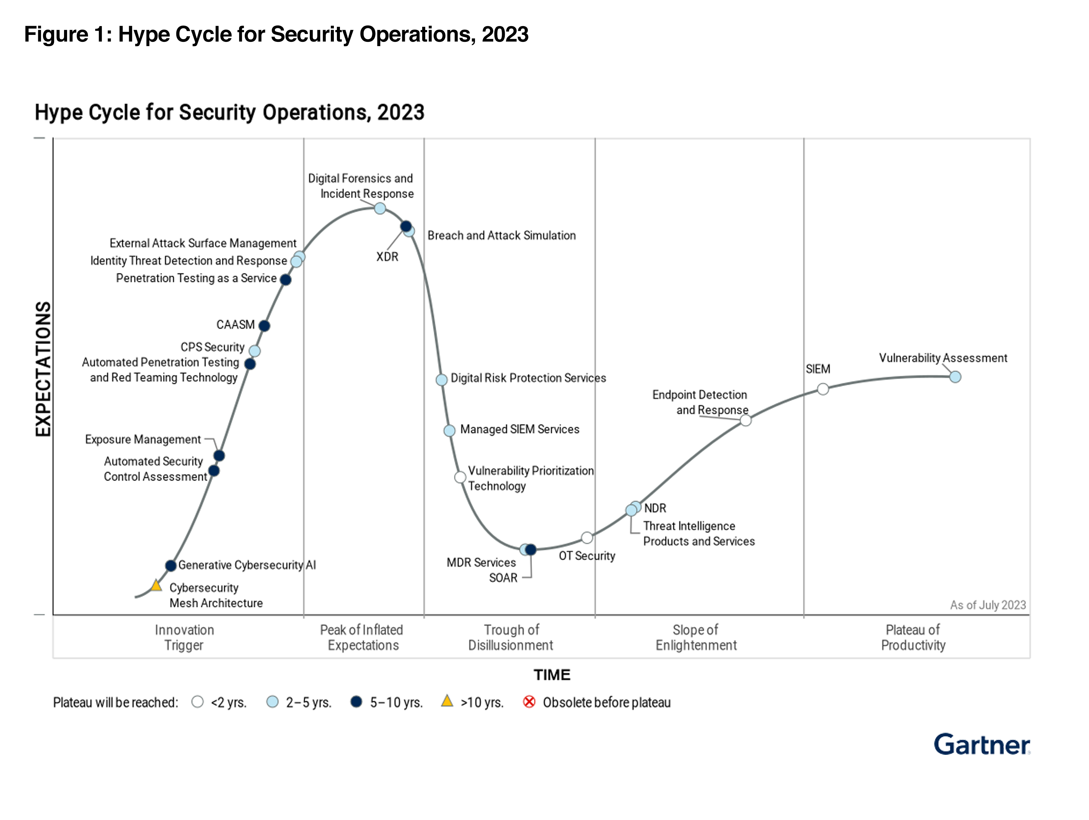
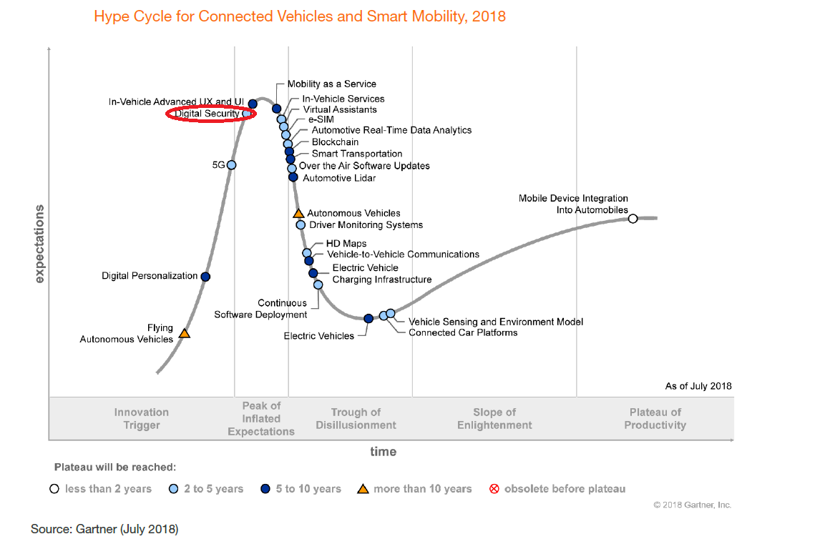
Automotive
Cybersecurity Hype Cycle
GenAI led cybersecurity solutions for automotive are an innovation trigger
4

Slide 5


Automotive
Cybersecurity
Today
+ 3 to 5 Years
Transition
Partially Connected Human Driven Cars
CASE | C - connected, A - automated, S - shared, E – electric
Software Defined Vehicles Governing Safety
Transition to Software Defined Connected Vehicles brings Substantial Safety, Security And Liability Risks For Automakers
3

Slide 6

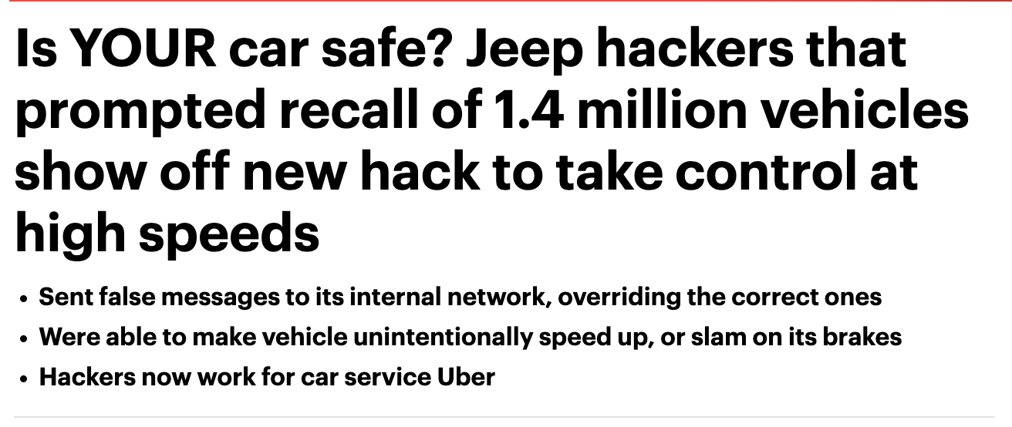


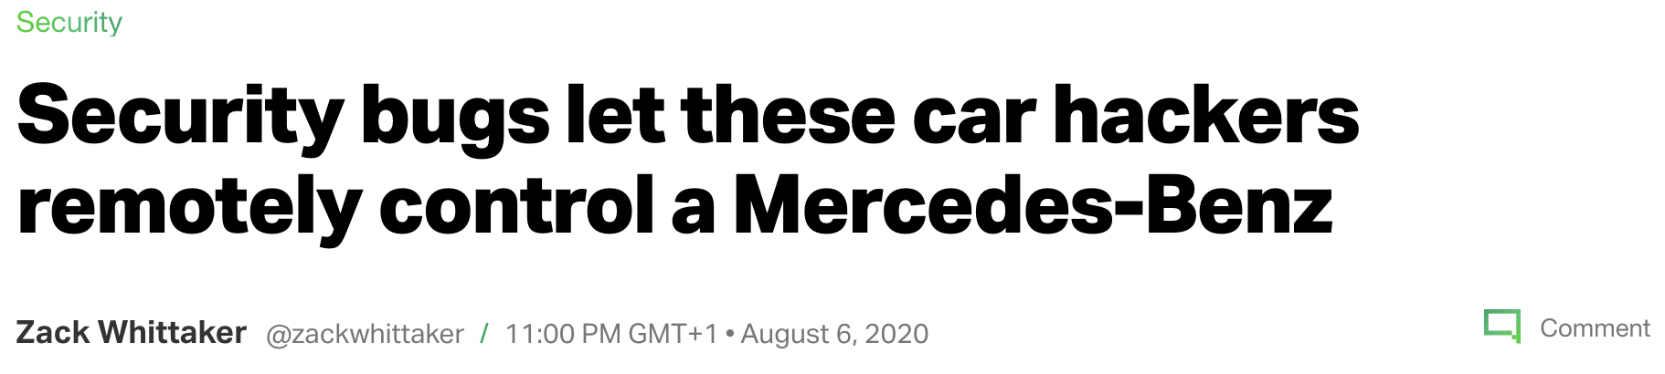







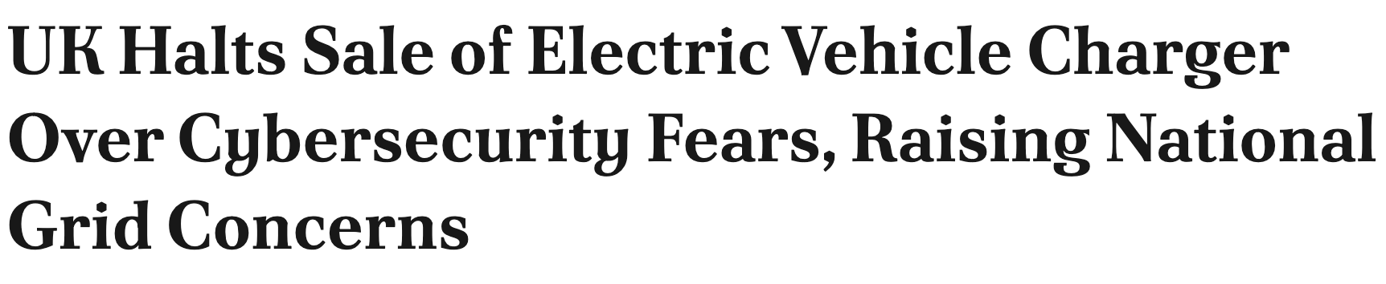

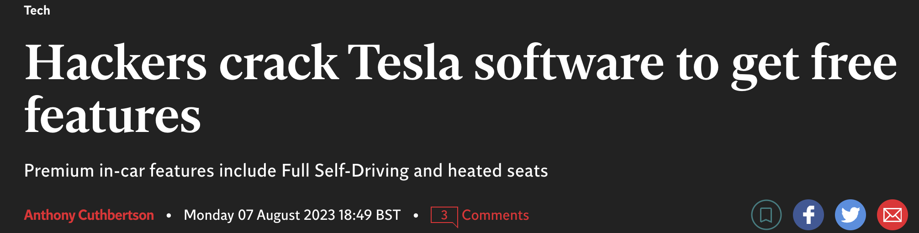


Cybersecurity Attacks on Rise
Mobility companies have seen an exponential rise in automotive cybersecurity attacks
Aug 2023-
Dec 2022-
Apr 2022-
Feb 2021-
Aug 2020- 2019-
2019-
2017-
Attacks on telematic servers account for 43% of all attacks (up from 35% in 2022) and
Attacks on infotainment systems account for 15% of all attacks (up from 8% in 2022).
5

Slide 7

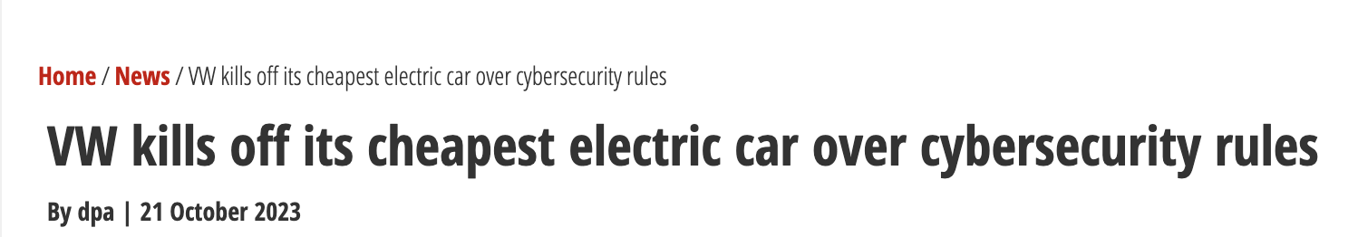
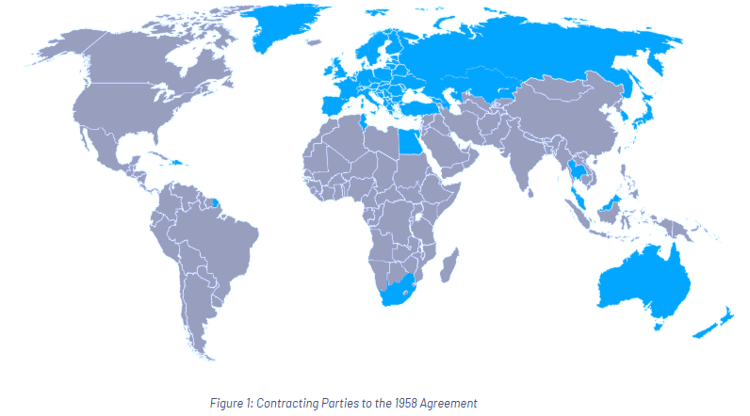
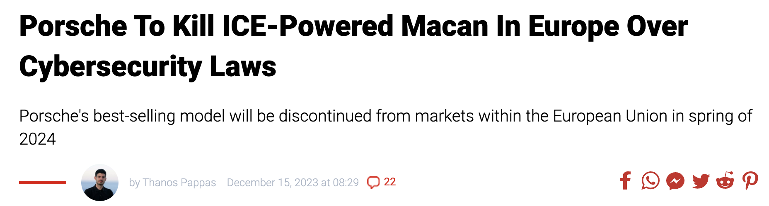
Regulations
Is driving compliance & is a legal requirement
Every automotive organization requires a well-established Cybersecurity Management System [CSMS]
INCOMING REGULATIONS
UNECE
July 2024
China GB/T 2025
India (Draft) 2027/28
Non-compliance means
Loose Access to Market
Financial Damage
Operational Loss
Loss of Privacy
4

Slide 8
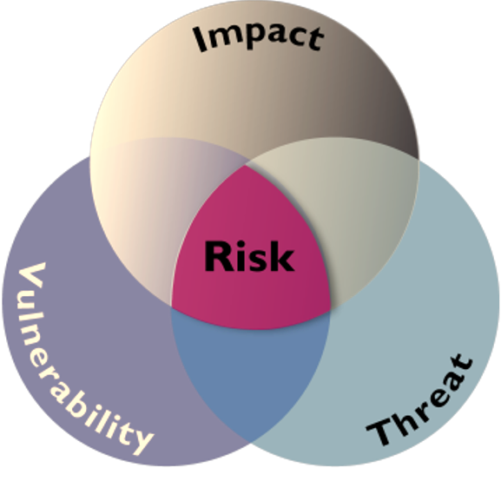
a
So what’s the Problem ?
Conducting Cyber Risk Assessments - Tooling
Excel Based TARA Tools for Threat Modelling
TARA becomes a STATIC and an Incomplete document
With fixed number of assets
Limited threat scenarios
Is Labor Intensive
Requires significant effort to map Threat Scenario’s and Risk Mitigation
Leading to
Impacts [Safety , Financial , Operational , Privacy]
More Vulnerabilities
Greater Risk
Result
Lack of experienced personnel to conduct TARA Assessments
Significant/continual human effort required to conduct TARA on >60 ECU’s /Vehicle
5
TARA – Threat and Risk Assessment (ISO/SAE 21434)

Slide 9
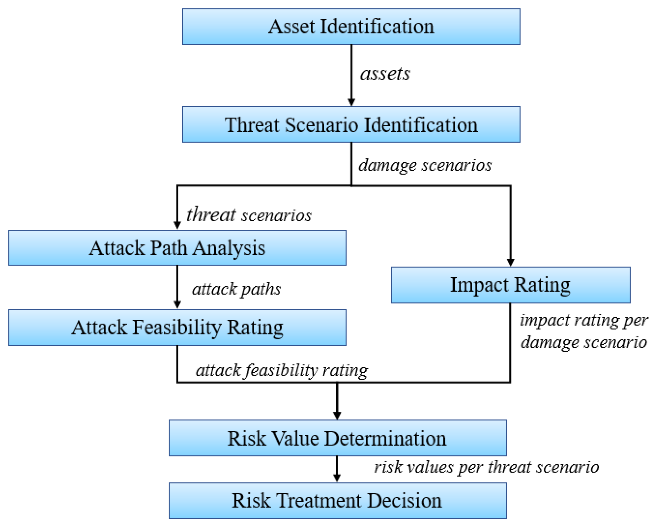
ISO/SAE 21434 based TARA
Threat Modelling Steps
Threat modelling comprises six essential steps ​
Assets​ [SW, HW, Data etc]
Threat Scenario generation for the Asset [CIA Triad compromise of Asset]
Attack Path Feasibility Rating
Impact Rating
Risk Determination and
Mitigation Strategies​
6

Slide 10
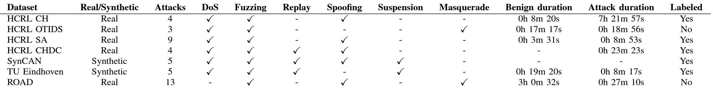
Datasets for Training
Cybersecurity Pre-Labeled Data
Detection using Open-Source vehicle dataset
Training of Text based Model using CRISKLE data
Integration in CRISKLE
Scenario Set Up Parameter​ | Value​
Data Set Name​ | Real ORNL Automotive Dynamometer (ROAD) CAN Intrusion Dataset ​
Type of Bus System ​ | CAN ​
Number of Attack Captures in Dataset​ | 13​
Number of ECU's in dataset​ | 106​
Total Time of recorded dataset​ - Attack | 30 minutes​
No. Of Ambient captures ​ | 12​
Attack Types​ | Fuzzing, Spoofing and Masquerade ​
Attack Nature (CIA) property​ | Authenticity, Integrity ​
7
ROAD – ORNL - https://zenodo.org/records/10462796

Slide 11
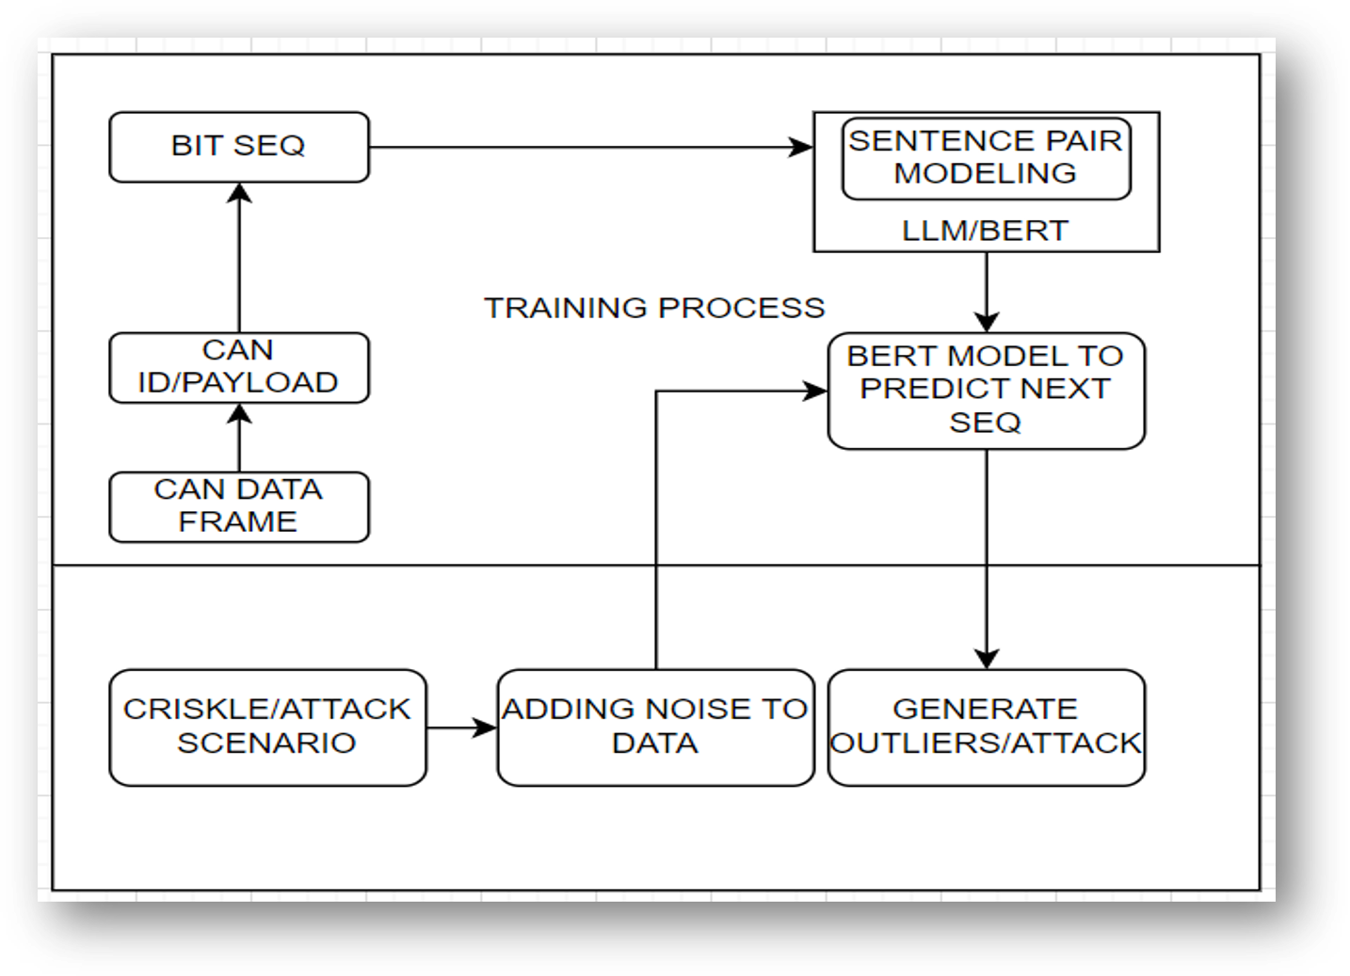
Model Architecture/Overview Setup
Detection using Open-Source vehicle dataset
Training of Text based Model using CRISKLE data
Integration in CRISKLE
8

Slide 12
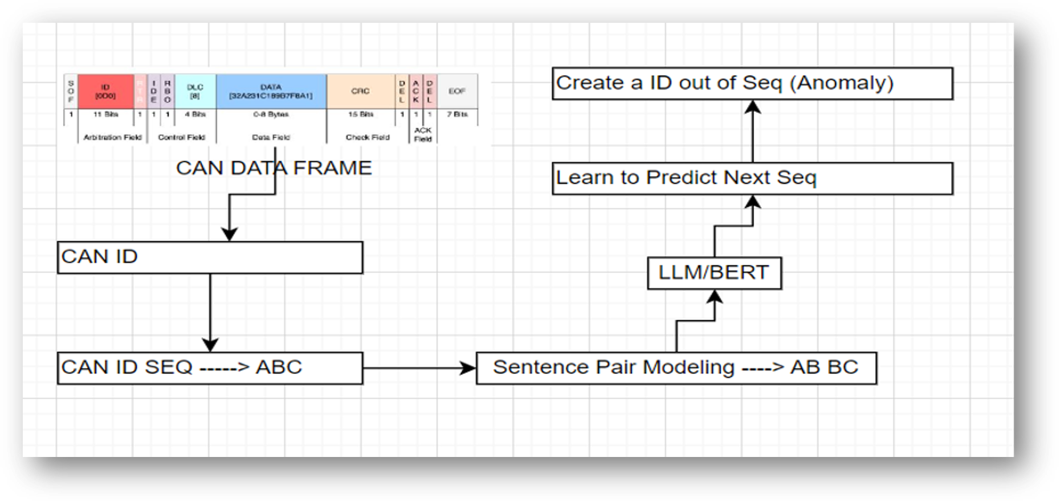
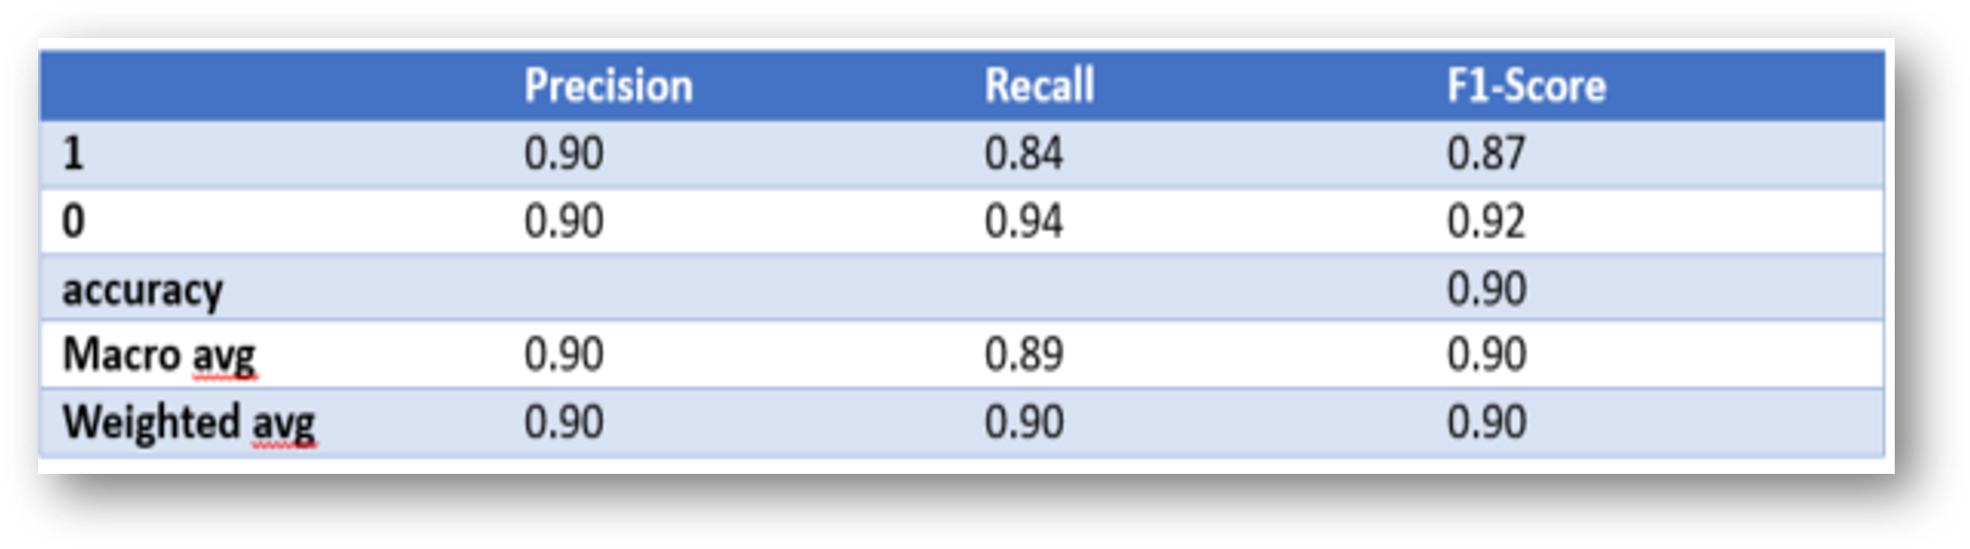
Attack Detection
SBERT Applied Using Sentence Pair technique on Pre-Labeled Benign ROAD CAN Data
Detection using Open-Source vehicle dataset
CAN Data Frame [Benign data]​
CAN ID Sequencing​
Sentence Pair Modelling​
BERT/LLM Training for Sequence Prediction​
Sequence Anomaly Detection​
Generate Anomalies​
Training of Text Based Model using CRISKLE Data
Integration in CRISKLE
BERT, excels at predicting the next sequence using a sentence pair technique.
9
SBERT : Sentence Bidirectional Encoder Representations from Transformers

Slide 13

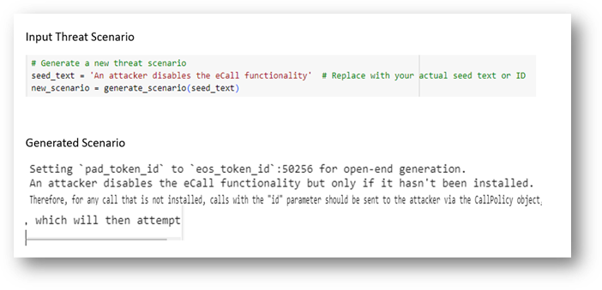
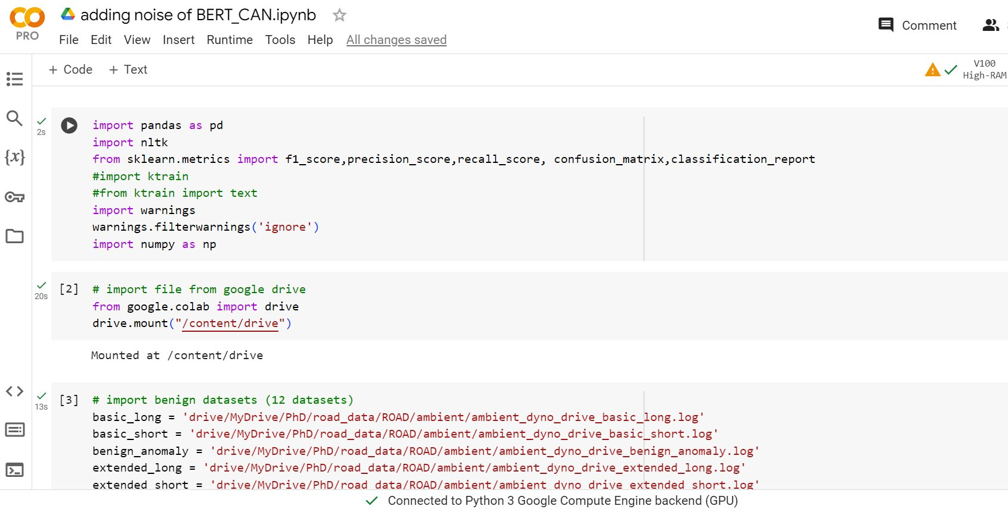
Model Training – Trial 1
Threat Scenario Generation using GPT 2.5 without any system context data
Detection using Open-Source vehicle dataset
Training of Text based Model using CRISKLE data
Integration in CRISKLE
Output :
Incomplete Threat scenario
Random in nature // Hallucinated
No context
12

Slide 14
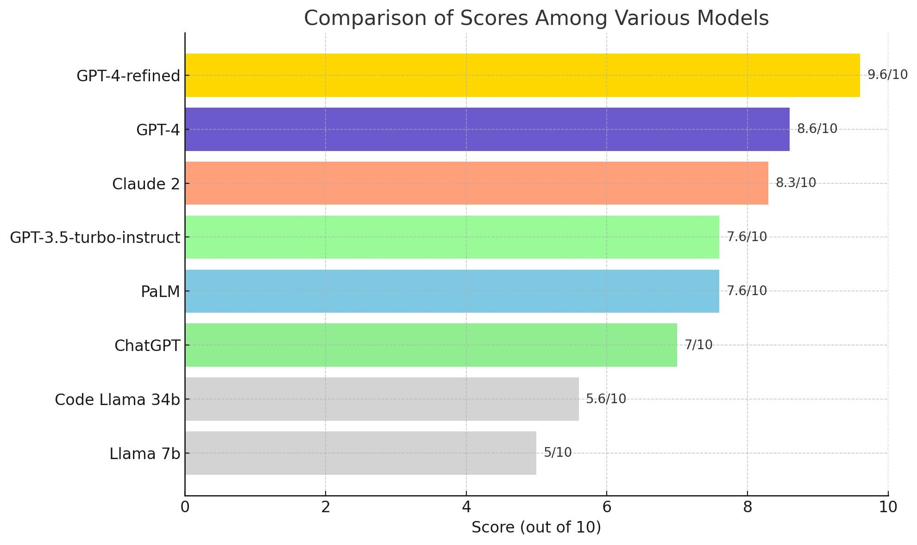
LLM Model Comparison
Model Size and Customisation
Detection using Open-Source vehicle dataset
OpenAI – Customisation possible using Open AI platform.
Training of Text based Model using CRISKLE data
LLAMA – customisation not possible in the cloud. Provides Generic output
Integration in CRISKLE
CLAUDE – customisation not possible in the cloud. Provides Generic output
GEMINI – customisation not possible in the cloud. Provides Generic output
18

Slide 15
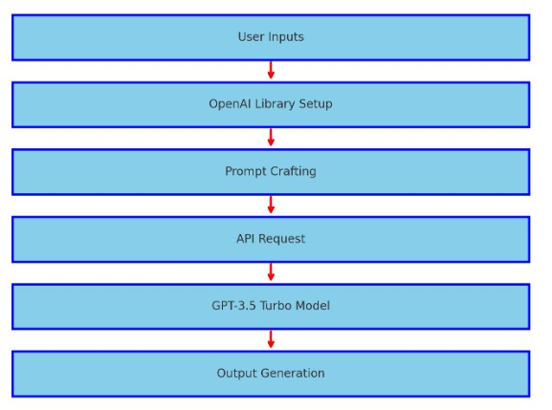
Model Training – Trial 2
OpenAI based Retrieval Augmented Generation (RAG) - Threat Scenario Generation
Detection using Open-Source vehicle dataset
Training of Text based Model using CRISKLE data
Integration in CRISKLE
+ Retrieval Augmented Generation
13

Slide 16
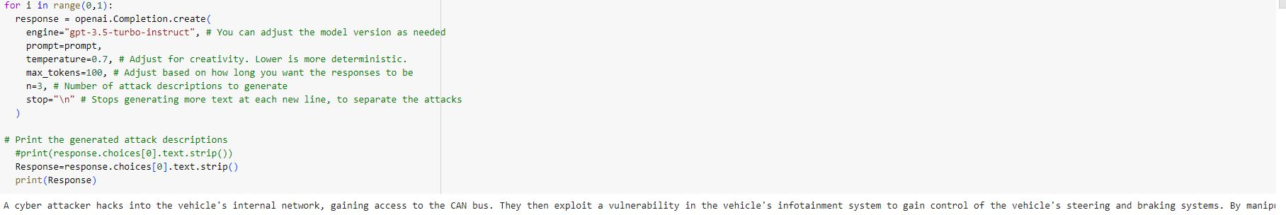
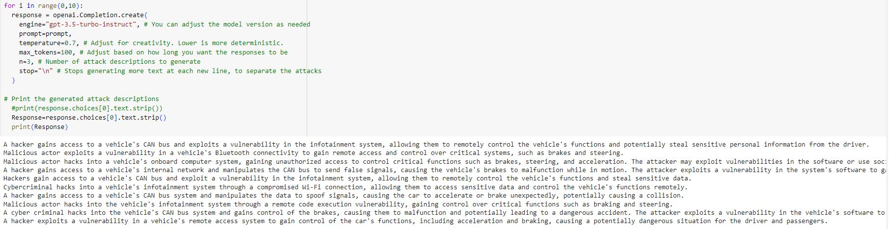
Model Training
Retrieval Augmented Generation (RAG) and Approximate Nearest Neighbor (ANN) - Threat Scenario Generation
Detection using Open-Source vehicle dataset
1 Generated Threat Scenario
Training of Text based Model using CRISKLE data
Integration in CRISKLE
10 Generated Threat Scenario
Output :
Complete Threat scenario
System based Contextualised output
14

Slide 17

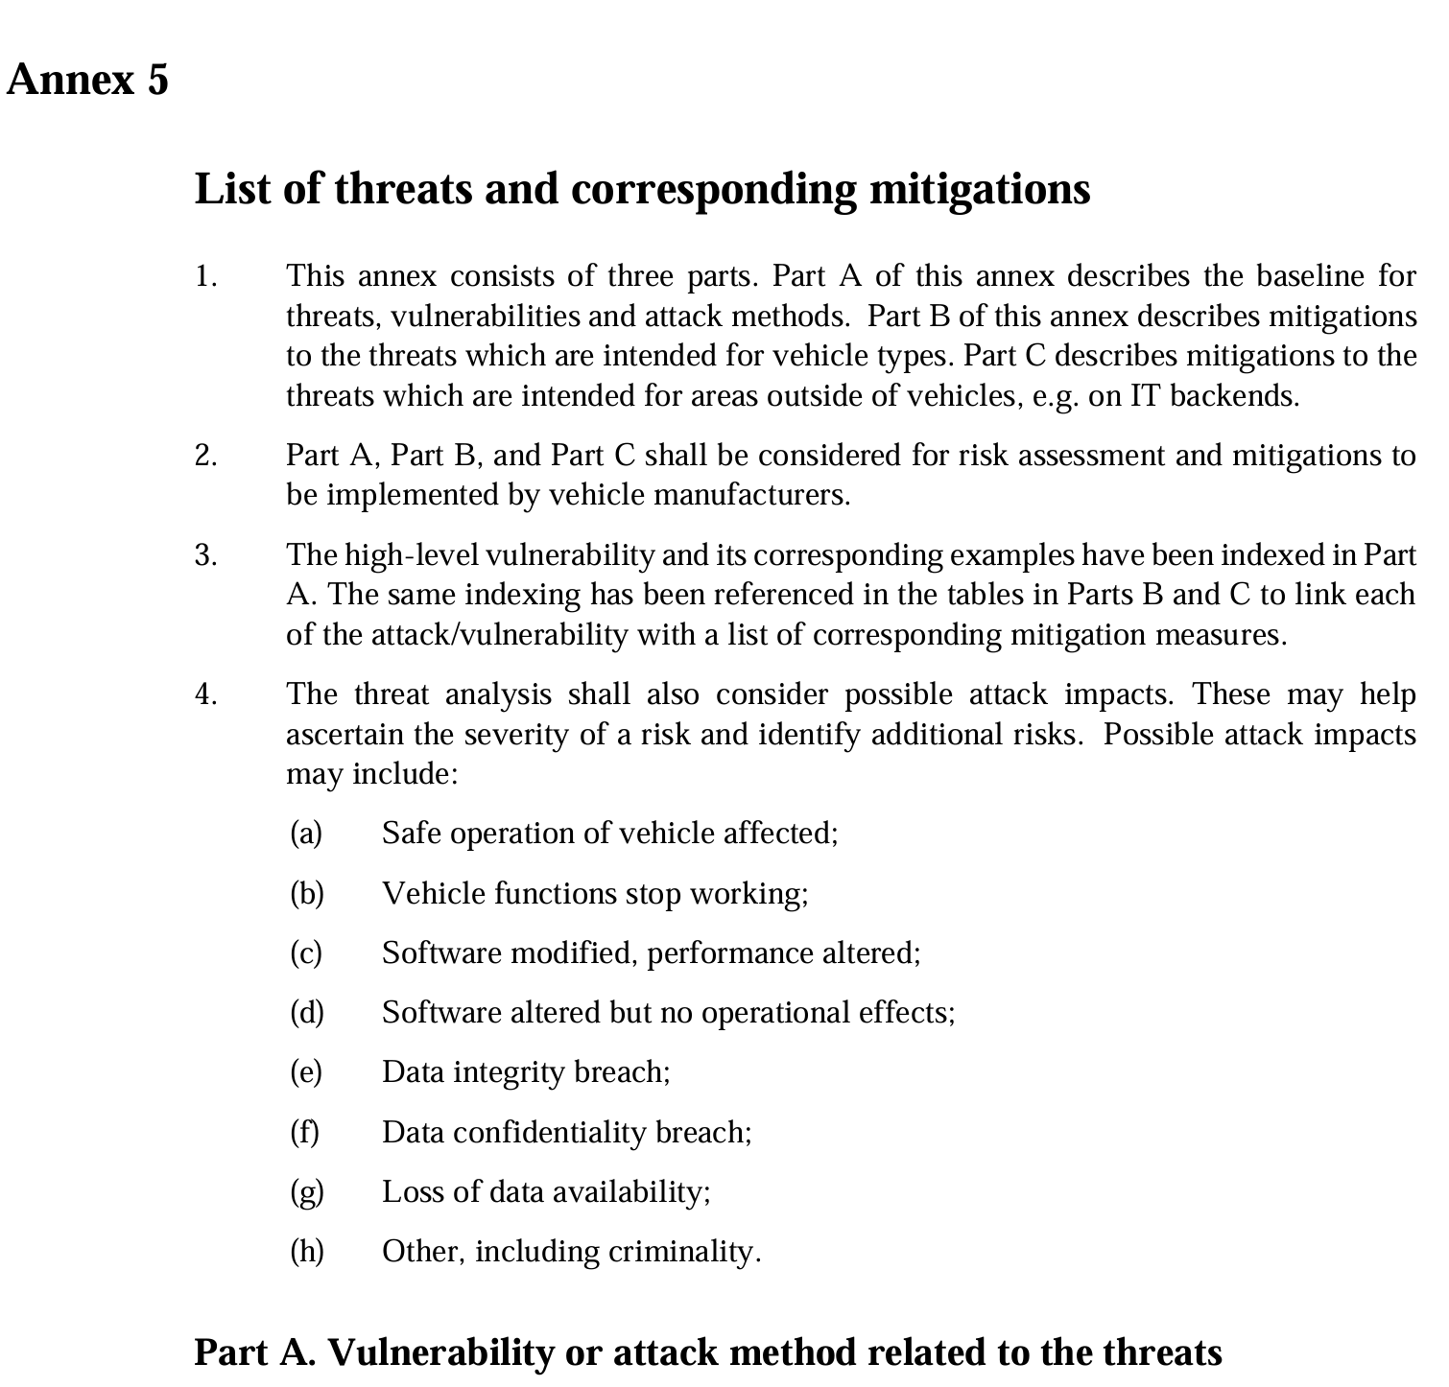
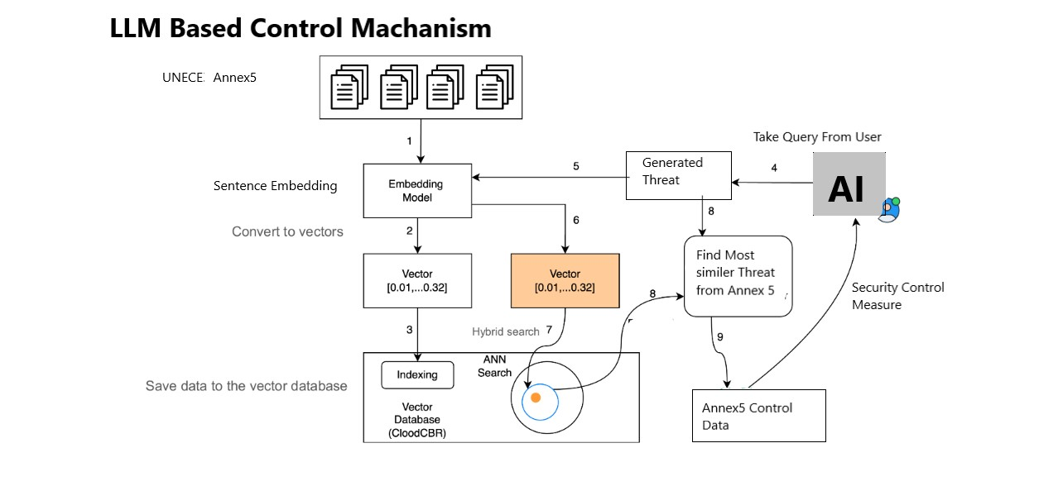
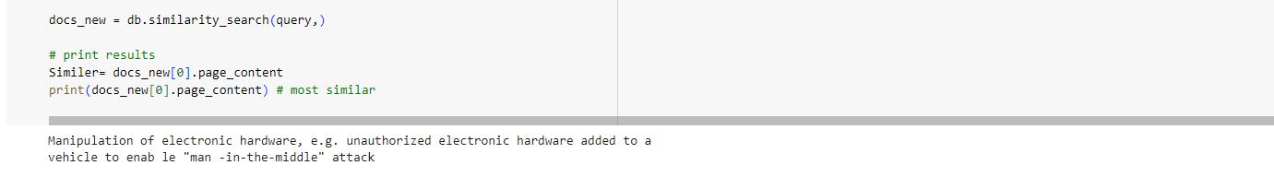
Model Architecture
Threat Scenario Confirmation as Listed in Annex 5 - ANN based Similarity Search
Detection using Open-Source vehicle dataset
Training of Text based Model using CRISKLE data
Integration in CRISKLE
Similarity Search with R155 Annex 5
13

Slide 18
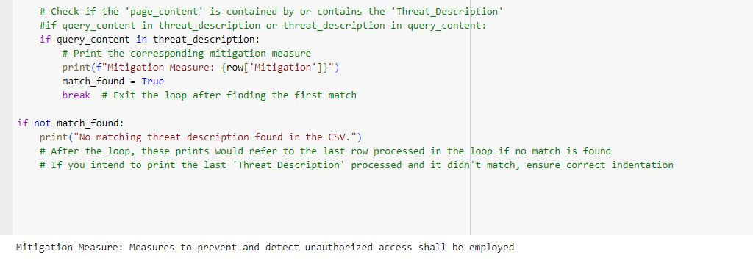
Mitigation – Security Controls
Mitigation – Security Controls (R155 Annex 5)
Detection using Open-Source vehicle dataset
LLM Based Control Mechanism used for Security Control determination - Model
Training of Text based Model using CRISKLE data
Integration in CRISKLE
15

Slide 19
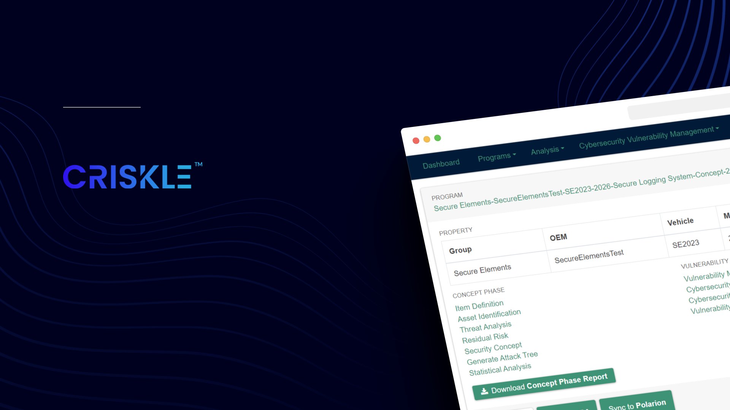
Integration of Model
Product Cybersecurity Engineering Application
Integrates Systems, Safety and Cybersecurity Engineering Processes to assess
Product Cybersecurity Risks and
Cybersecurity Vulnerabilities
Through out the Product Lifecycle
6

Slide 20
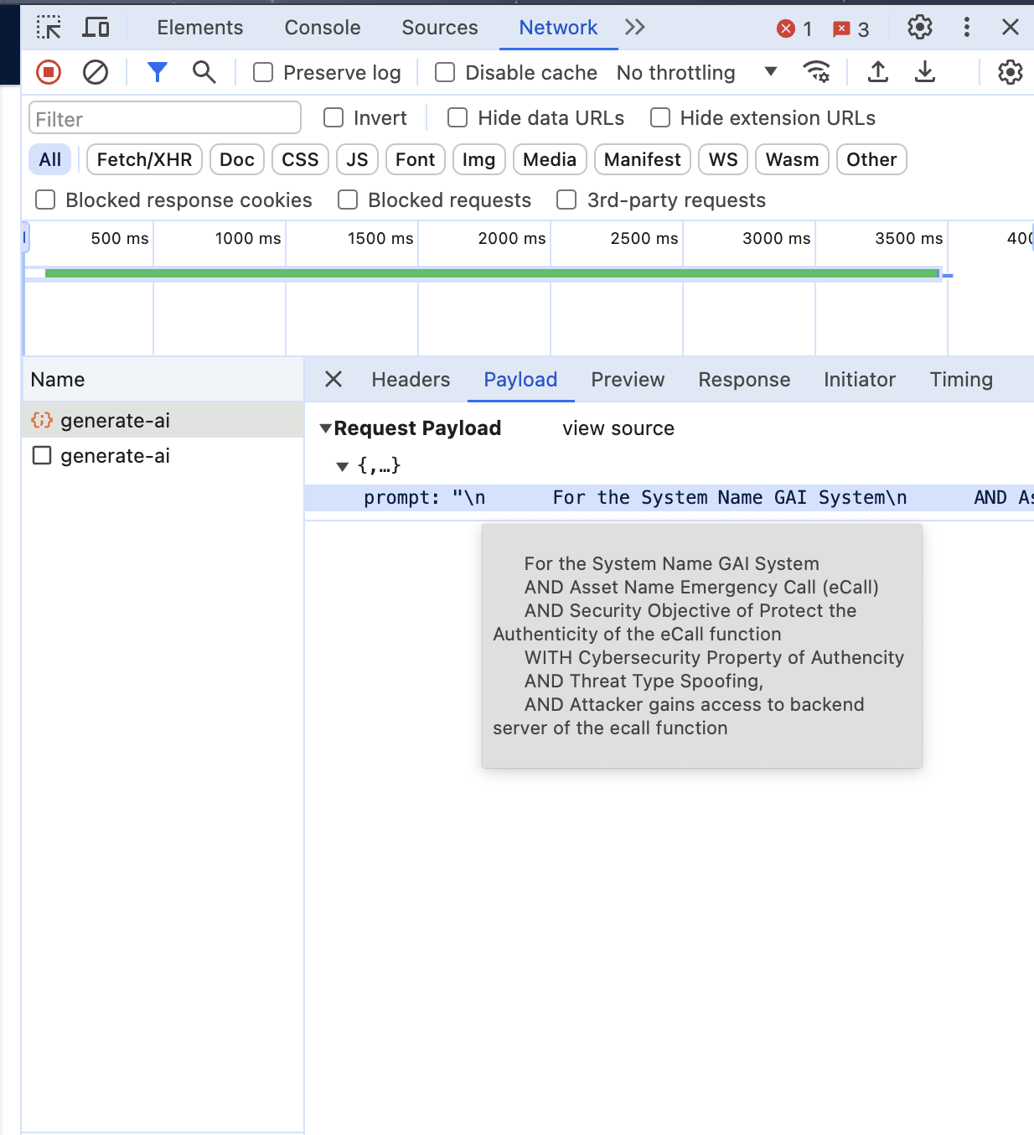
Application Integration
Model Integration in CRISKLE
Detection using Open-Source vehicle dataset
Inputs to the Threat Scenario Model
LLM generated Threat Scenario in CRISKLE, where, system Inputs are provided using templates : Default Template {
System Name
Asset Name
Security Goal/Objective
Cybersecurity Property
Is threat type part of WP29 Annex. 5:
Define Threat Sub-scenario:
Threat Type: Spoofing
Threat Scenario text (User Input) }
====================================================================
Example scenario generation template:
{
For the System Name Connected and Automated System
AND Asset Name CANSignalName
AND Security Objective of Protect the Authenticity of the CAN Signal
WITH Cybersecurity Property of Authenticity
AND is part of WP29 of Threats related to Vehicle Communication Channel
WITH this Threat sub-scenario Loss of vehicle data and code
AND Threat Type Spoofing
AND Threat Scenario Description Attacker gains access to in vehicle CAN communication bus via remote access
}
Training of Text based Model using CRISKLE data
Integration in CRISKLE
16

Slide 21
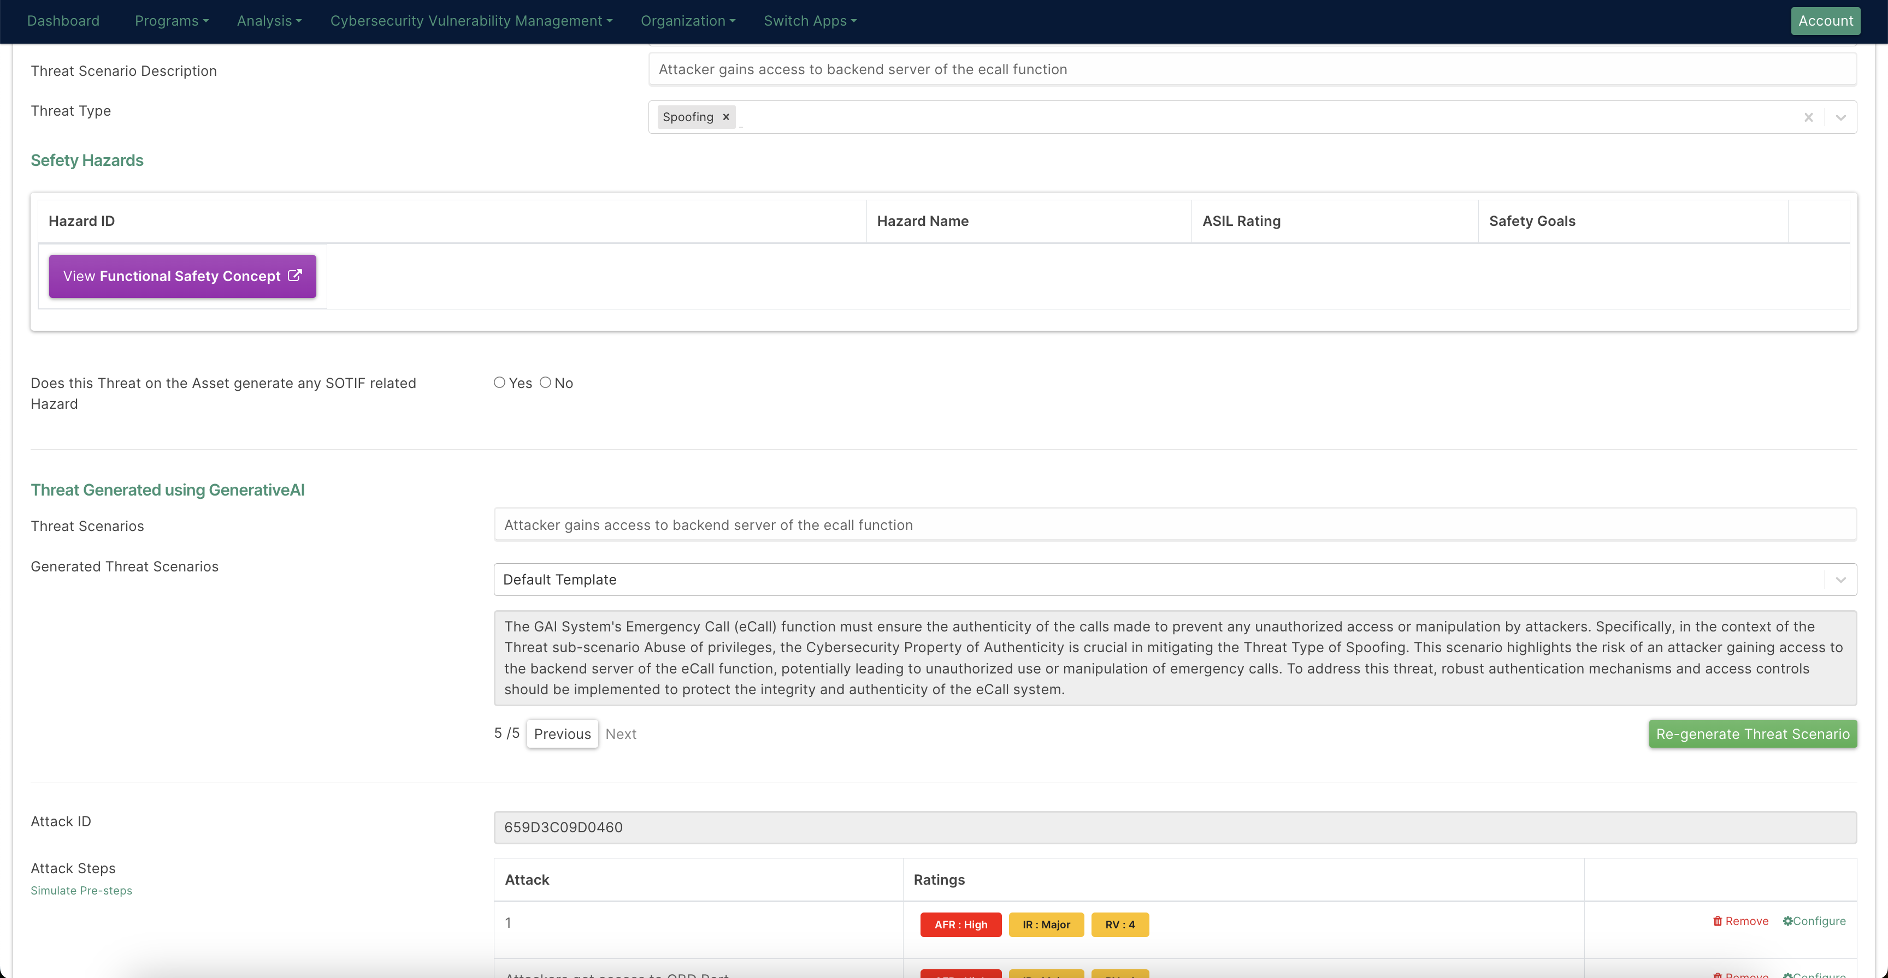
Application
Integration in CRISKLE TARA screen using OpenAI API
Detection using Open-Source vehicle dataset
Training of Text based Model using CRISKLE data
Integration in CRISKLE
18

Slide 22
a
Conclusion
It is possible to generate quality threat scenarios and mitigation controls for cybersecurity assessments by leveraging LLM’s.
Excel Based TARA Tools for Threat Modelling
GenAI Based TARA Tools
TARA becomes a static dynamic document
Capability to generate/auto complete threat scenario/s
Auto complete relationship between Threat Scenarios and Mitigations
Reduces labor, increasing speed of performing TARA thereby increasing productivity.
Steps beyond minimal regulatory specification and looks at wide areas of Attacks (subject to model training)
Lack of experienced personnel to conduct TARA Assessments
Result
AI/LLM based TARA Tools can assist engineers' complete assessments at speed but with continual human oversight
Significant/continual human effort required to conduct TARA on >60 ECU’s /Vehicle
Reduced labour/time/cost
19
TARA – Threat and Risk Assessment (ISO/SAE 21434)

Slide 23
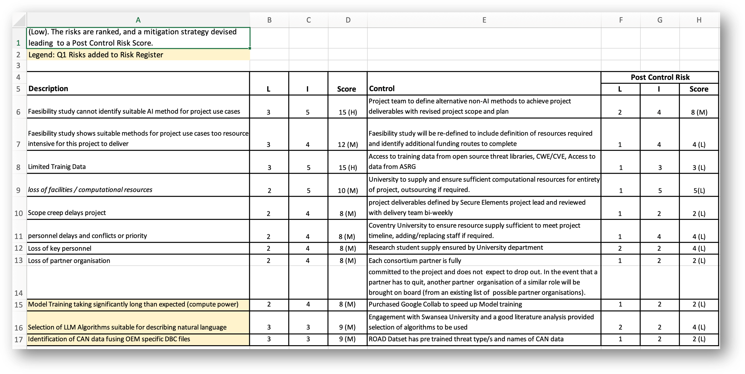
Challenges
GDPR/Privacy concerns
Key Challenges
Limited training data
Limited Time – 6 months [Challenging for Certifying and Annotating results]
GDPR/Privacy of data [confidentiality] was not part of project but must be thoroughly addressed.
Model training takes long time [HPU needed]
Careful selection of LLM algorithms.
Access to real vehicle data, DBC data and CAN Logs.
23

Slide 24
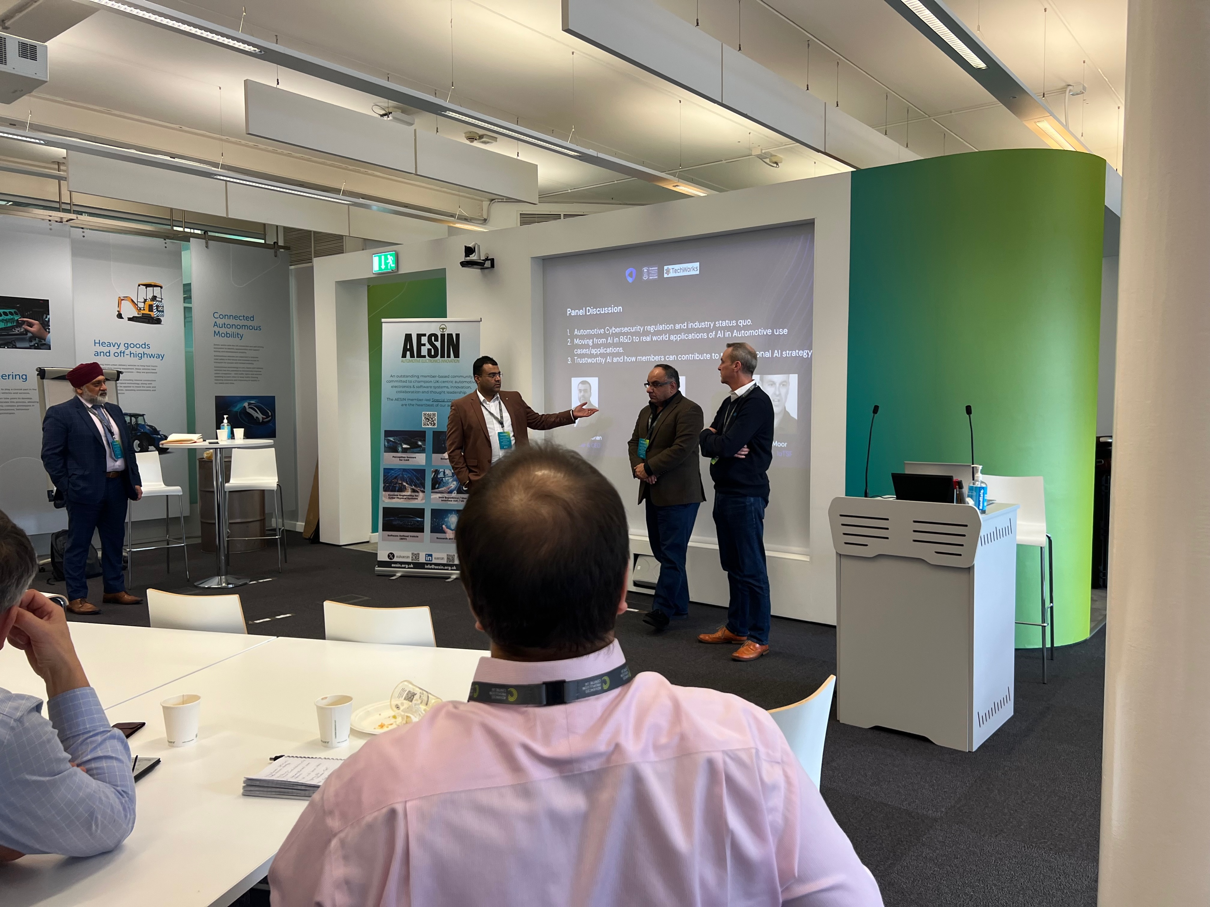
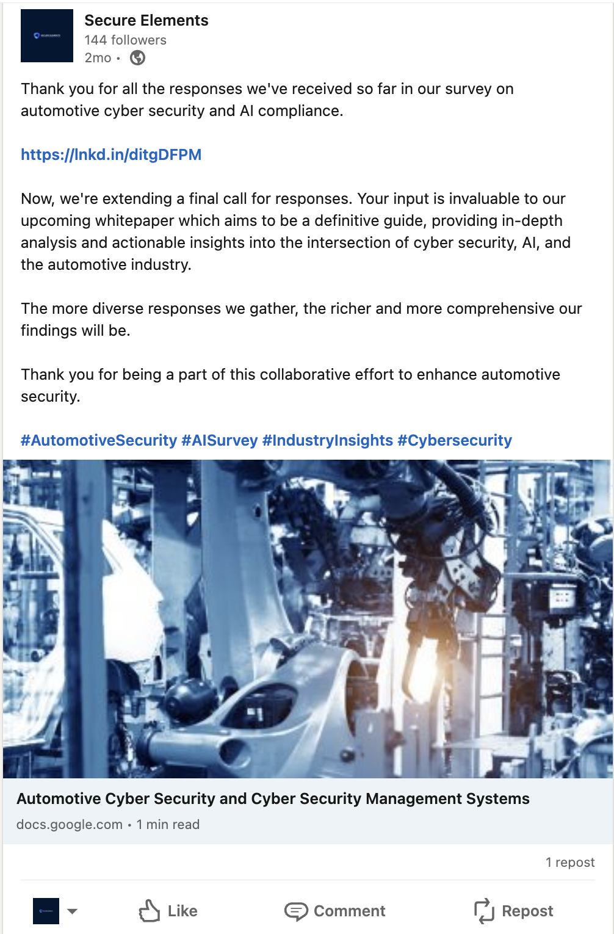

Project Achievements
Some of our achievements this quarter -
Research Paper submitted for ITS World Congress 2024​ - Accepted
Attended the AESIN Plenary for Project Dissemination activity
LinkedIn Campaign​ - Data being put together
In line to submit a paper for Automotive Cybersecurity ESCAR 2024 Conference for EU.
20

Slide 25


Company Details
Thank you
Registered at
Secure Elements Ltd.
Interested in Trialing CRISKLE for Cybersecurity Risk Assessments to achieve UNECE R155 compliance ?
Contact Details
Mr. Saket Mohan
Email: saket.mohan@secureelements.co.uk

